Slide 1
SMART
Stopping Malware and Researching Threats

Slide 2
IETF Note Well
This summary is only meant to point you in the right direction, and doesn't have all the nuances. The IETF's IPR Policy is set forth in BCP 79; please read it carefully.
The brief summary:
By participating with the IETF, you agree to follow IETF processes.
If you are aware that a contribution of yours (something you write, say, or discuss in any IETF context) is covered by patents or patent applications, you need to disclose that fact.
You understand that meetings might be recorded, broadcast, and publicly archived.
For further information, talk to a chair, ask an Area Director, or review the following:
BCP 9 (on the Internet Standards Process)
BCP 25 (on the Working Group processes)
BCP 78 (on the IETF Trust)
BCP 79 (on Intellectual Property Rights in the IETF)
Also see: http://www.ietf.org/about/note-well.html:

Slide 3
Agenda
Chair Time, Charter & Group Setup (Kathleen / Kirsty) - 20 minutes
Problem Space in Cyber Security (David McGrew) - 10 minutes
Threat Landscape in Cyber Security (Arnaud Taddei) - 15 minutes
Testing for the good of the internet (Simon Edwards) - 20 minutes
BGP hijacking (Toma Gavrinchenkov) - 20 minutes
CLESS draft on endpoint security (Arnaud Taddei) - 15 minutes
One Snake (NCSC Senior Speaker) - 20 minutes)

Slide 4
SMART RG - Headlines
Advisory research group on attack defence.
Research methods to efficiently and effectively detect, mitigate, prevent or eliminate threats.
Guide IETF protocol development.
Become the authority on attack defence and prevention in the IETF/IRTF.

Slide 5
What research we would like to see
case studies of previous incidents and attacks: how they were prevented, detected, mitigated
best practice, e.g. use of DMARC, to prevent phishing
new methods for prevention, detection and mitigation – including automation
reports and statistics on the current threat landscape
how to spot slow and bulk data exfil from a network reliably
endpoint detection capabilities and limitations
threat detection on encrypted traffic
or research we are completely unaware of!
Notes:
The RG will only succeed with your contributions.

Slide 6
Draft Charter
The Stopping Malware and Researching Threats Research Group (or SMART RG) will research the effects, both positive and negative, of existing, proposed and newly published protocols and Internet standards on attack defence. It will gather evidence from information security practitioners on methods used to defend against attacks and make this available to protocol designers, implementers and users. As a result, designers, implementers and users of new protocols will be better informed about the possible impact on attack prevention and mitigation. The SMART RG aims to guide IETF protocol development and become the hub of expertise on attack defence in the IETF/IRTF.
> https://github.com/smart-rg/drafts/blob/master/draft-charter.md

Slide 7
Further links
Wiki page: https://trac.ietf.org/trac/irtf/wiki/smart
Mailing list: https://www.irtf.org/mailman/listinfo/smart
Datatracker: https://datatracker.ietf.org/group/smart/about/
Github: https://github.com/smart-rg
CARIS2: https://www.internetsociety.org/events/caris2

Slide 8
Coordinating Attack Response at Internet Scale (CARIS 2) Workshop
Kathleen Moriarty
ISOC Workshop
ISOC & Dell EMC sponsored

Slide 9
Some presented Research and Development Work
OpenC2
NICT - Security Automation and Visualization
Incident response coordination - various groups presented
IPv6 aggregation - MAPRG

Slide 10
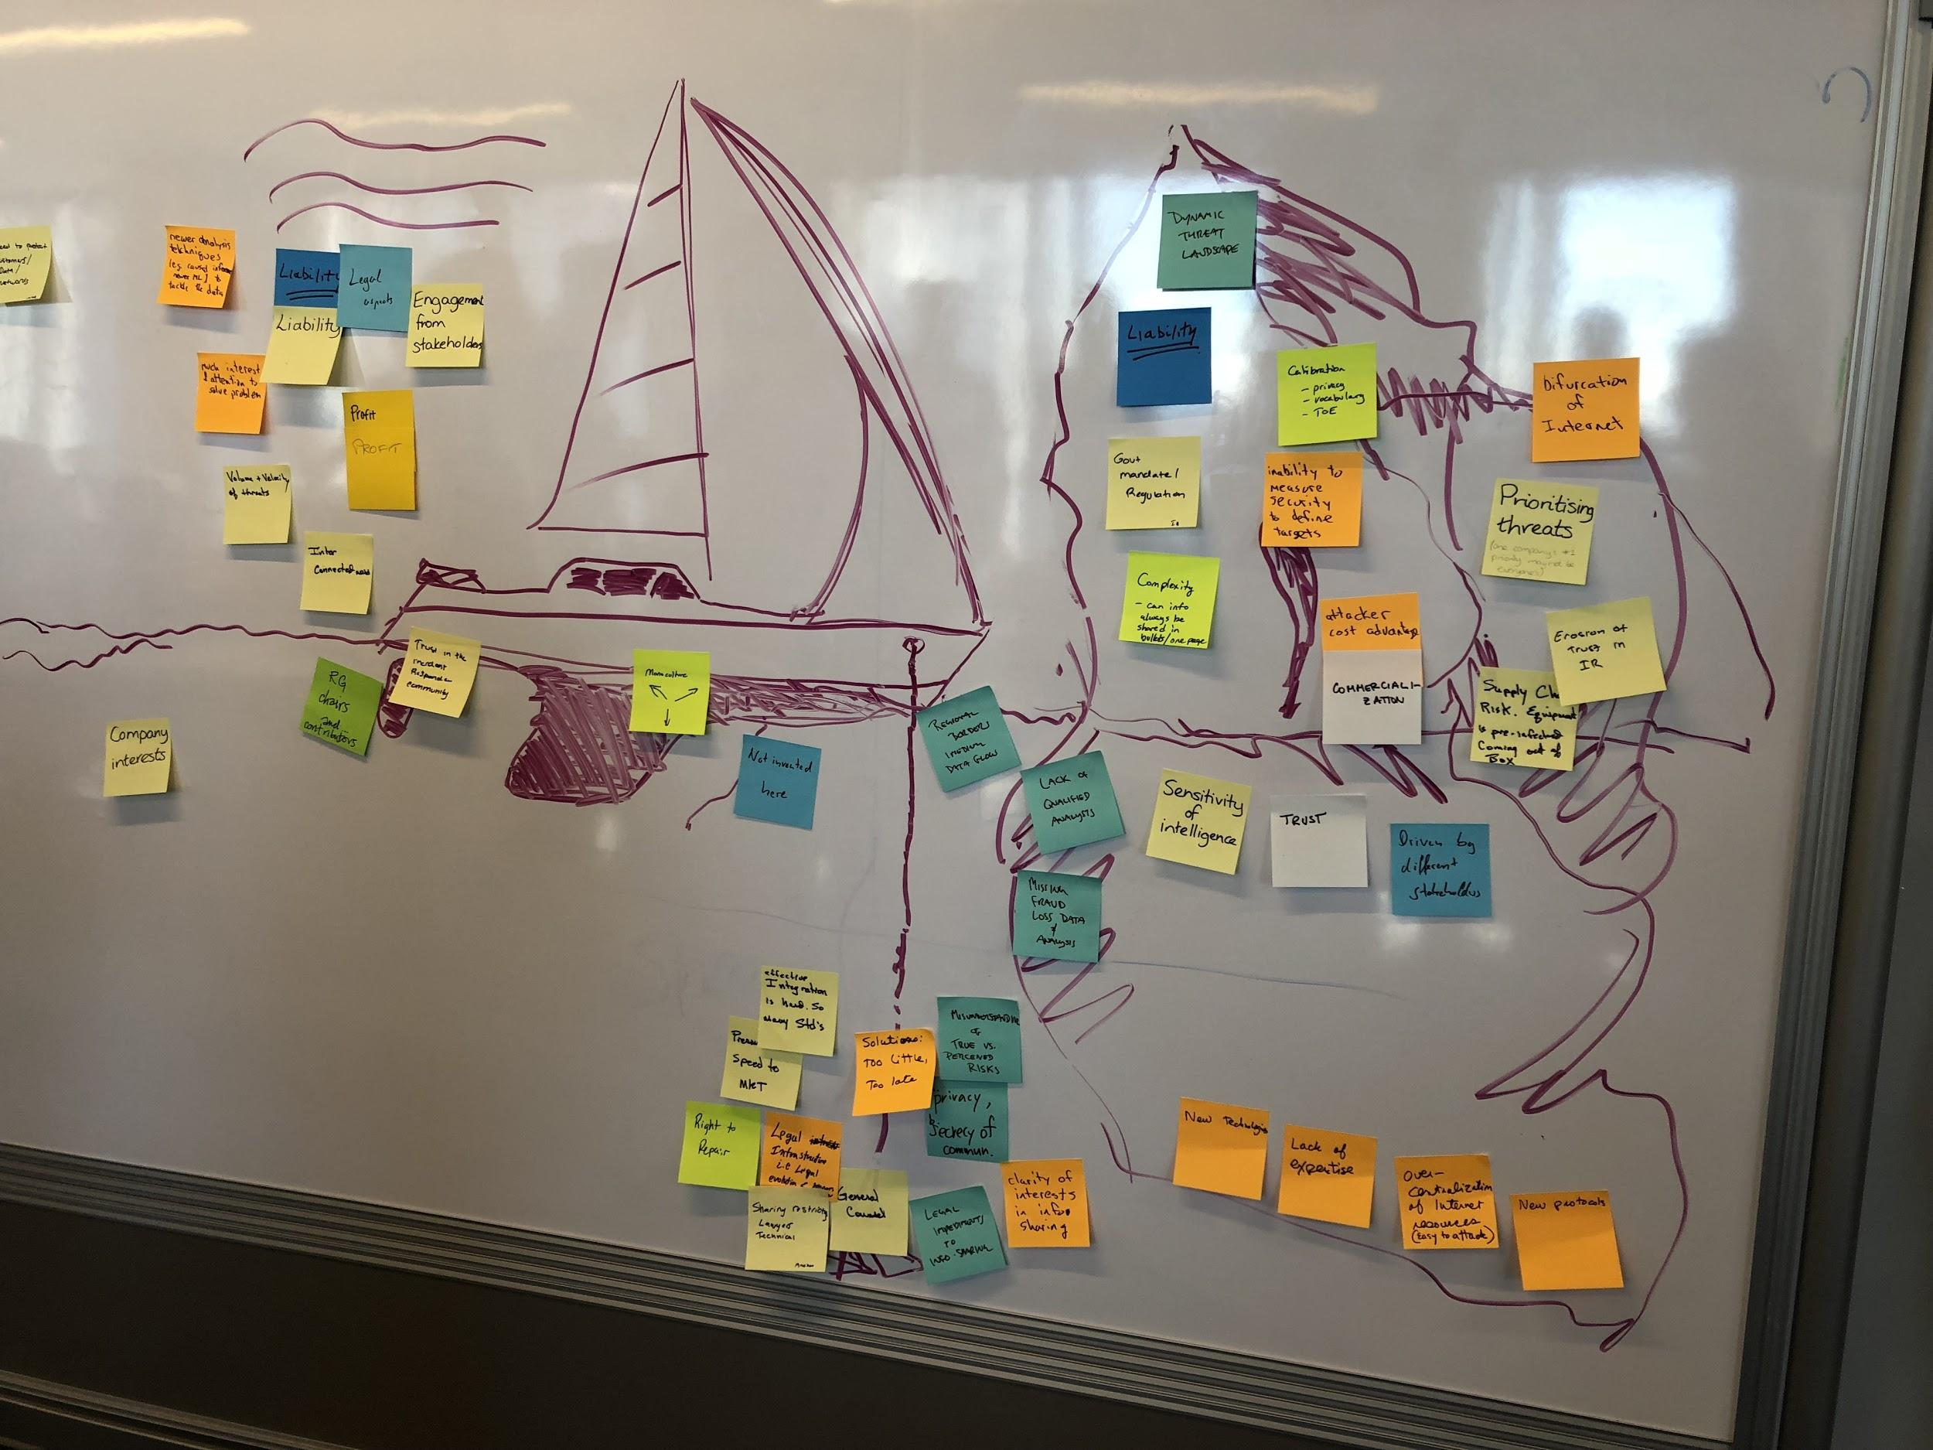

Slide 11
Incident Response Today
Supporting
Trust in incident response teams
Need to protect network as a forcing function
Current efforts supported by profit
FEAR - initially a burst of wind, but eventually leads to complacency
Dragging
Too many standards
Regional border impact data flows
Lack of Resources/Participation
Monoculture
Looming problems ahead
Dynamic threat landscape
Liability
Bifurcation of Internet
Lack of skilled analysts
Sensitivity of Intelligence/trust

Slide 12
Breakout Brainstorming, may lead to work for SMART
Fingerprinting
packet comparisons
SNARC - uses trust indicator to make decisions about good/bad actors
builds on zero trust networking
research visual aspect and underlying principle
similar theme on IP reputation/BGP ranking
Attack coordination solutions/automated security
Cryptographic Rendezvous
L2 discovery

